Slide 1

Machine Learning Model Validation Framework
Overview of model validation framework and techniques for machine learning models.

Slide 2

The motivation and the topics
The objective is not to create a new model validation structure but to enhance the existing risk model validation framework with insights on machine learning models. This enhancement will address specific challenges associated with ML and might also consider issues that are shared with conventional modeling approaches.
While the European Union (with GDPR) and the United States have made significant strides in addressing bias and fairness during modeling, these concerns haven't been as pronounced in the UAE. Nevertheless, considering the financial and reputational setbacks experienced by prominent tech firms, it's timely to investigate these matters
Data-related challenges are prevalent in banking, including issues of privacy, quality, bias, drift.

Slide 3
Agenda
Introduction
Data
Model
Bias and Fairness
Drift

Slide 4




What is model validation and Why do we need it?
Ensure model operates as expected
Evaluate risks
Meet business needs
Manage risks
Model validation identifies potential risks like bias and monitors model performance over time.
Validation guarantees the model aligns with and achieves business objectives.
It puts controls in place to mitigate risks that could impact model performance or lead to issues.
Model validation verifies the model performs according to specifications and requirements.
In summary, model validation is crucial to ensure models operate correctly, evaluate risks, meet business goals, and manage those risks effectively, mandated by cbuae

Slide 5



Why AI/ML
Improves through experience
Data has great value
Widely used including banking
Machine learning models improve performance on specific metrics through experience from data.
Data is like oil for ML models, generating value through training.
ML is used in many sectors like search, phones, agriculture and banking for efficiency.
Machine learning leverages data to improve through experience and is widely used including in banking. Tools like auto ml (H2o), causal inference(DoWhy) make life easier.

Slide 6



Why ML models need validation
ML models have risks
High risk models
Regulations
Depending on the use case, ML models can have different levels of risk
Models like credit scoring systems face stricter obligations from regulators
Regulators mandate fairness, accountability and transparency(FAT) for high-risk models
ML models, especially high-risk ones, need validation to ensure they meet regulatory and performance requirements including risk mitigating before put to the market

Slide 7
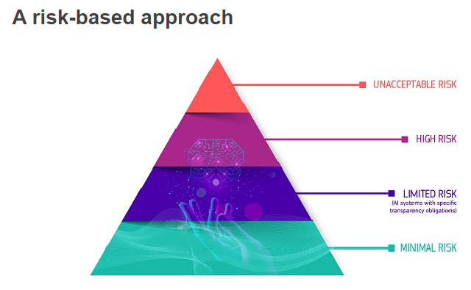
Why ML models need validation
European commission share the risk tier for machine learning product as above figure.

Slide 8
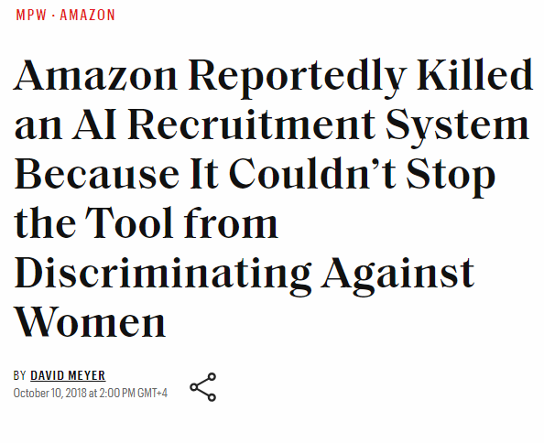
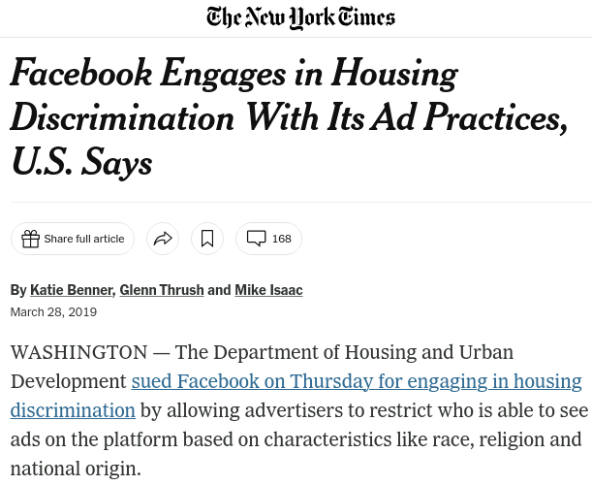
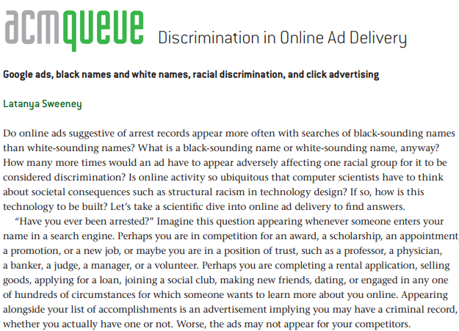
What is model validation and Why do we need it? - II

Slide 9
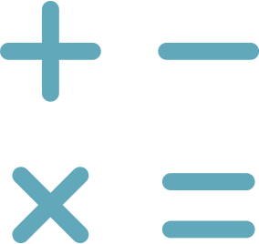

What issues AI/ML present
Data issues
Model issues
Data collection, quality, sampling, transform, lineage, monitor, privacy
Pre-modeling, in-modeling like black box, post-modeling monitor
Proper data and model validation needed throughout the ML pipeline to ensure quality.

Slide 10
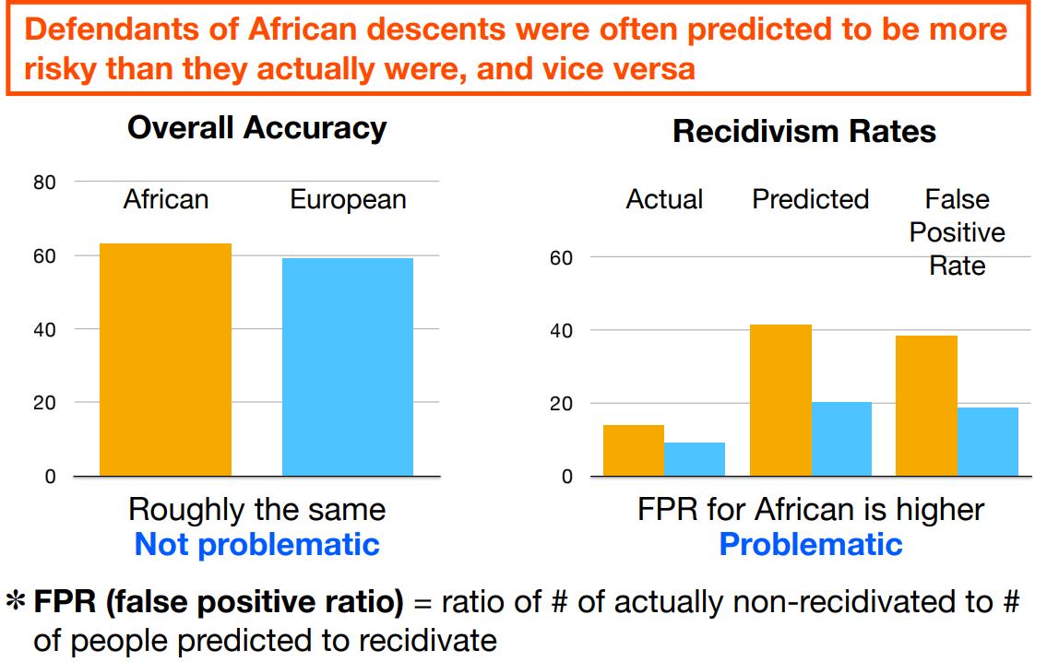
Compas Case Study
The Compas recidivism model, developed by Northpointe, aimed to predict defendants' risk of reoffending. However, investigations found that the model was biased against African-Americans, who were often assigned higher risk scores than white defendants with similar profiles.

Slide 11
Data – I
Data collection bias
Measurement bias, coverage bias, social bias exist in historical data
Data completeness
Evaluate time period, data sources, distribution, labeling definition
Data sampling bias
Data may not represent the population if only approved loans available for the outcome (ri)
Data lineage
Track data transforms to understand how bias propagates
Data drift
Monitor statistical distribution changes over time
Data privacy
Techniques like PII, K-Anonymity, Differential Privacy to protect sensitive data

Slide 12



Data Issues II
Data quality issues
Insufficient data
Imbalanced data
Data Error, Missing values, outliers, duplicates and noise in the data can impact model performance.
If the data set is inadequate and can't represent the whole data set, then training can lead to poor model performance.
Class imbalances can affect the model's ability to learn patterns for the minor classes.
Careful data collection, sampling, cleaning and balancing is critical for building effective machine learning models.

Slide 13
Data Issues III
In 2020, a data error caused by the loss of nearly 16,000 positive COVID-19 test results in UK, possibly resulting in 50,000 people not being told to self-isolate.
So-called airline “mistake fares”, which are sometimes unintentionally discounted by more than 90%, have force airlines to either lose money or injure their reputations by failing to honor these “glitch prices”.
Facebook provided a dataset to a group of social scientists that left out half of all its US users, affecting the findings in academic work studying the impact of social media on elections and democracy.
The video game company Unity lost $110 million on their AI advertising system after ingesting bad training data from a third party
Business may suffer huge consequence if overlooking the data quality issue.

Slide 14




Model - I
Black box nature
Internal validation
Explainability
Unseen data testing
AI/ML models are often complex black boxes, making it hard to understand how they arrive at decisions
Validate model on design, hyperparameters, loss function, metrics aligned with business objectives
Explain model outputs to ensure they make sense and identify potential biases
Evaluate model performance on new, unseen data to ensure robustness
Evaluating AI/ML from multiple angles is crucial to ensure fairness, accountability and transparency.

Slide 15
Model - II
Methodology alignment
The methodology should align with business needs.
Hyperparameter tuning
Tune hyperparameters to improve model performance.
Optimization function
Choose an appropriate optimization function for training.
Loss function
Select a loss function that matches the business objective.
Performance metrics
Metrics should align with or proxy the business objective.
Model stability
Assess model stability via weight confidence and cross-validation.
Sensitivity analysis
Analyze sensitivity with methods like PDP plots.
Scenario testing
Simulate scenarios and stress test the model.

Slide 16

Model - III
Model explainability is important in areas like finance and healthcare where decisions can have major impacts on people's lives. It allows humans to understand why a model makes certain predictions and helps identify potential biases.

Slide 17
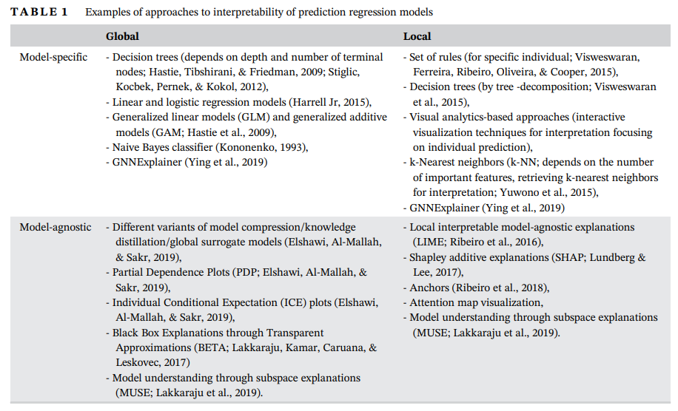
Model – IV

Slide 18
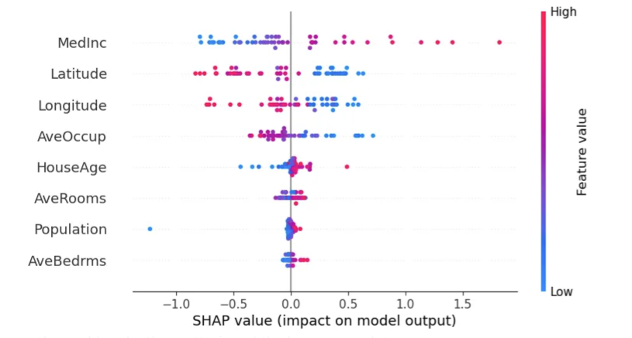
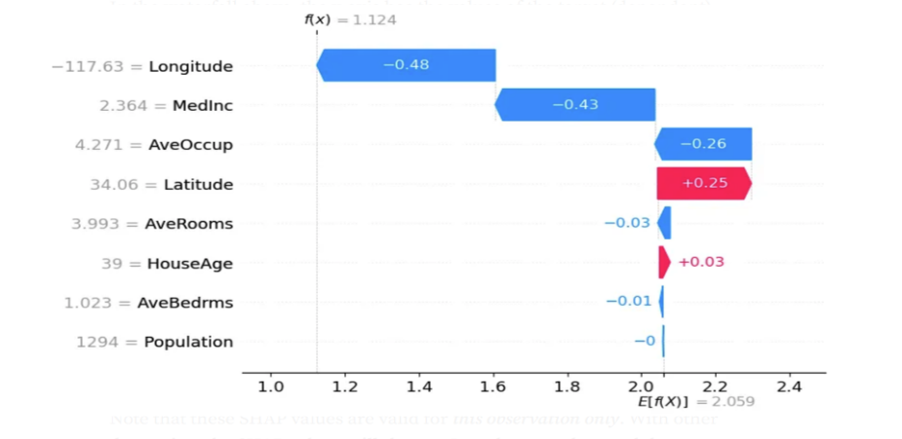
Model – V

Slide 19
Model - VI
Language/Tool Used
Version Control
Micro-service/Container
Python code converted to Kedro pipeline and deployed using GitHub Actions by data science platform team.
GitHub used for distributed version control.
Flask API implemented as service, deployed through Docker containers.
Documentation
Infrastructure
Model Documentation using confluence.
Kedro pipelines and Jenkins, GitHub Actions used for workflow automation deployment.

Slide 20


Model - VII
Decision Monitor (Approval rate, Accept rate etc)
Performance monitor (Default rate to F1,Accuracy, MAE)
Data Monitor (Drift detection)
Model Observability
Three lines of defense which is widely used in risk team
Notes:
Environment check，the ML monitoring system checks for metrics such as system CPU, memory, disk, I/O utilization, etc.
An ML Monitoring solution will be able to detect the performance degradation in the model. In contrast, an ML Observability solution will compare data distributions and other key indicators to help pinpoint the cause of the drift.

Slide 21
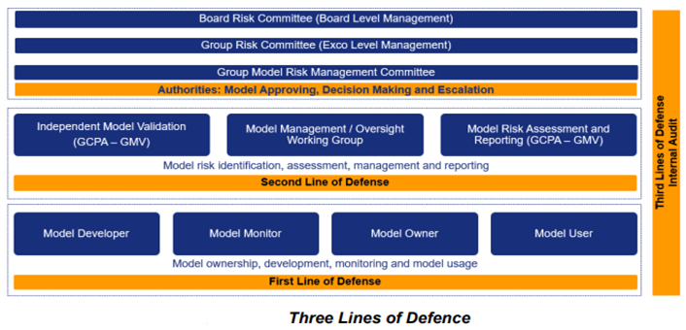
Model – VIII

Slide 22
Model - IX
Data Poison
Membership inference attacks
Model Extraction/Stealing

Slide 23

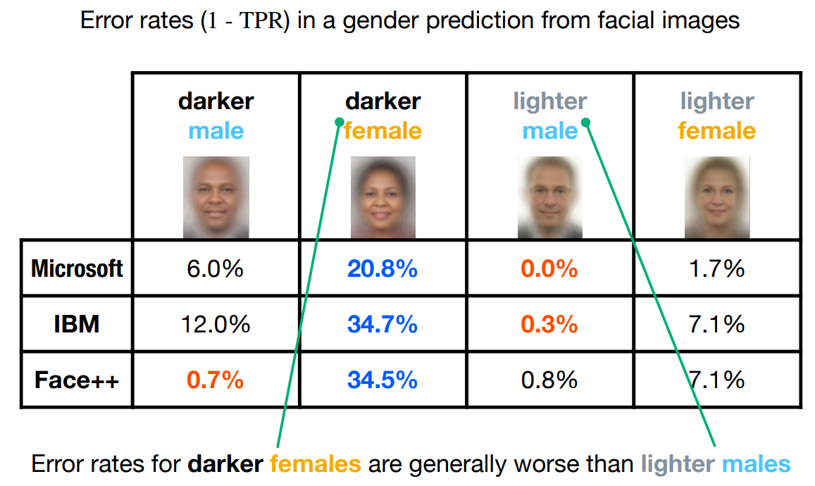
Bias and Fairness
Bias is systematic errors in the data and/or model that leads to potentially unfair outcomes.
Bias existed in the industry; even top technology companies also suffered from the bias problem.
Many bias problems are discussed before, we will brief mention inductive bias.
.

Slide 24


Bias and Fairness – Inductive Bias
Minority loan repayment records ignored
Biased assumptions
ML algorithms may assume minority individuals are less likely to repay loans, ignoring examples of those who have repaid
ML algorithms can make biased assumptions about minority groups that lead to unfair outcomes
Inductive bias occurs when assumptions in ML algorithms cause biased and unfair treatment.

Slide 25
Inductive Bias
Occam's Razor
Prefer simpler models, but may miss exceptions
Smoothness
Prefer smoother decision boundaries and curves
Sparseness
Prefer hypotheses with fewer features
Model Bias
Learned model may not match target model

Slide 26



Fairness Concepts
Equal treatment
Protected attributes
Fairness metrics
All individuals should be treated equally and without bias, regardless of protected attributes
Attributes like race, religion, national original, gender, marital status, age etc. should not be used to discriminate against people.
Metrics like demographic parity and equality of opportunity help evaluate model fairness across groups.
Ensuring fairness and mitigating bias is crucial for building ethical, trustworthy ML systems.

Slide 27

Fairness Metrics
Demographic parity
Equality of odds
Equality of opportunity
The model predictions should be consistent across various demographic subgroups.
The true positive rate and true negative rate should be equal for different subgroups.
The probability of true positives should be equalized across groupings of a protected category.
Using metrics like these can help measure and improve fairness in machine learning models.
More fairness metric, please refer to the working paper from Amazon Fairness Measures for Machine Learning in Finance

Slide 28



Data Debiasing
Fairness through Unawareness
Equalize data points
Data augmentation
Remove features correlated with protected attributes
Use sampling to have equal data points (or ratio) for each protected group
Generate more minority data synthetically to balance the dataset
By removing correlated features, equalizing and augmenting data, we can reduce bias caused by imbalanced training data.

Slide 29

Model Debiasing
Change model type
Ensemble modeling
Multi-task learning
Trying different model types like neural networks, random forests etc to see which has lower bias
Using multiple models together and combining predictions to reduce bias
Training model on multiple objectives to learn more generalized representations
By changing the model architecture and training process, we can reduce inherent bias and improve fairness.

Slide 30

Drift
The statistical properties of a dataset change over time. This concept drift can impact the performance and accuracy of machine learning models, which are often trained on historical data. When new data deviates from the training distribution, predictive performance may decline.

Slide 31
Causes of Drift
Seasonal Variations
Changing User Behavior
Data distributions can change due to seasonal factors like holidays, weather, etc.
User preferences and demographics evolve over time, altering data patterns.
Instrumentation Changes
External Events
Modifications to data collection tools and processes introduce variability.
Major events like regulations, economic shifts and
crises impact data.

Slide 32
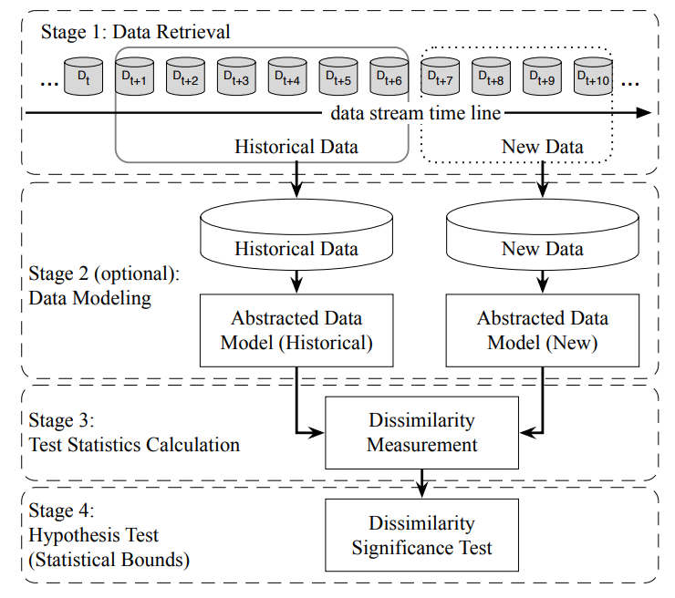
Drift Detection
Notes:
the need to segment your data as part of monitoring your data’s behavior

Slide 33


Drift Detection Methods
Statistical tests
Model-based approach
KS Test and PSI can detect distributional shifts in datasets, other KL divergence family (JS divergence) can also be applied
Train a classification model on reference dataset and monitor performance on test data
Statistical tests and classification models help detect and quantify data drift

Slide 34
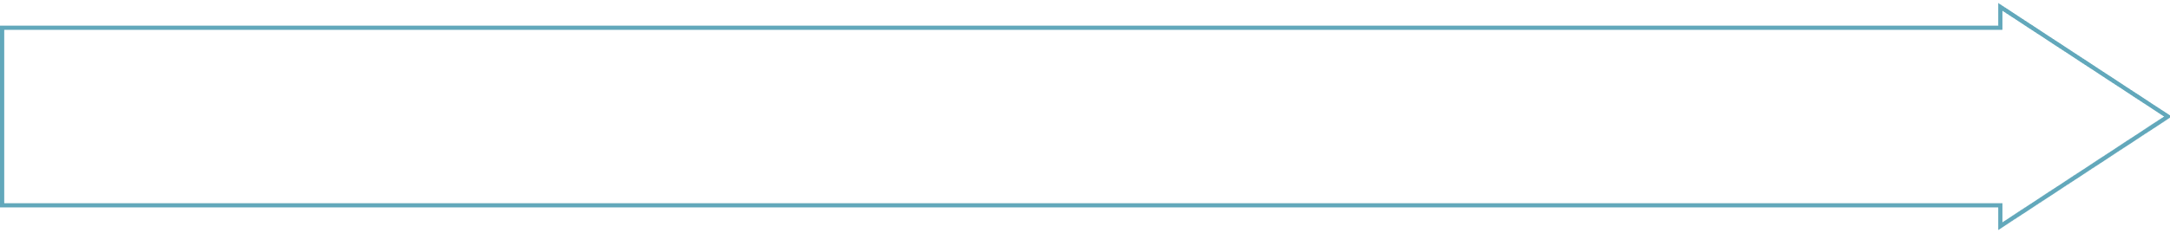

Mitigation Strategies
Retrain models frequently
Update model incrementally
Weight recent data higher
Ensemble models on new/old data

